Slide 1
First Set of Examples:
enums can now “inherit” from another type

Slide 2
First Set of Examples: Review of Enums
An enumerated type is a Java class all of whose possible instances are explicitly enumerated during initialization.
Example:
public enum Size { SMALL, MEDIUM, LARGE};
//usage: if(requestedSize==Size.LARGE)
applyDiscount();
The enum Size (which is a special kind of Java class) has been declared to have just three instances, named SMALL, MEDIUM, LARGE.

Slide 3
Review of Enums (cont)
Two important applications for enums:
Using enums as constants in an application
Weak Programming Practice: Create a class (or interface) containing constants, stored as public static final values – most often arising when constants are ints or Strings
Problem. No compiler control over usage of these constants when they occur as input arguments to methods (example on next slide)
Better Approach Represent constants as instances of an enumerated type.
Optimal, threadsafe implementation of the Singleton Pattern

Slide 4
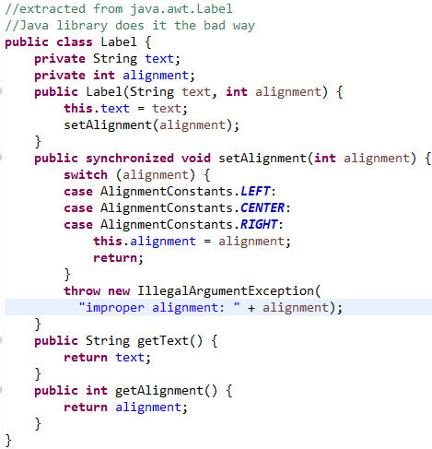
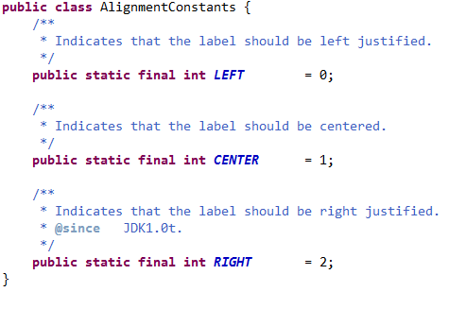
Example of Handling Constants in Java
In the java.awt package there is a class Label, used to represent a label in a UI (built using the old AWT). It makes use of constants to designate alignment properties: LEFT, CENTER, RIGHT. This use of constants is flawed, but it is a commonly used style

Slide 5
Problem: No compiler control over use of these constants. Could make the following call: Label label = new Label("Hello", 23);
You won’t know till you run the code that “23” is meaningless. The compiler sees that a value of the correct type has been used, but at runtime, 23 will be recognized as an illegal value.
It is better to control the values passed in with the help of the compiler. This is accomplished using an enum to store constants, rather than collecting together a bunch of public static final integers.

Slide 6
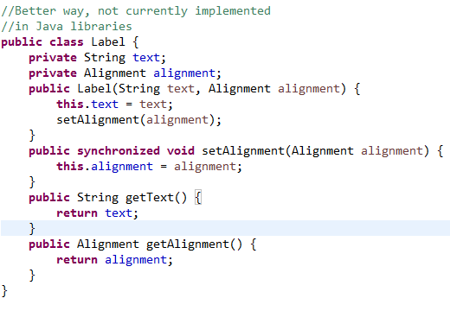
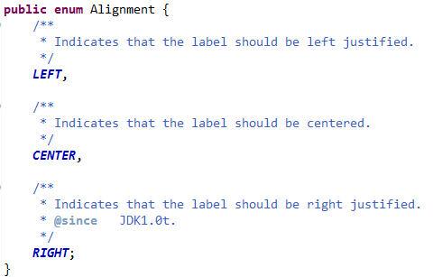
Improved Label Using enums

Slide 7
Review of Best Practice for Using enums
From Bloch, Effective Java (2nd edition):
Use enums (in place of public static final variables) whenever you need a fixed set of constants all of whose values you know at compile time.

Slide 8
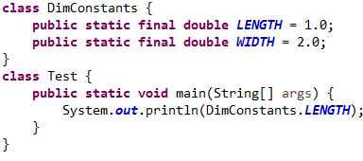
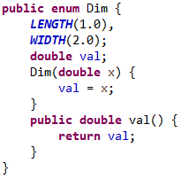

OPTIONAL SLIDE (Quickly) Best Practices, continued
Question: What if you have constants that must be of type int or String (or another type)?
(For lower left –
Dim.LENGTH calls constructor.
Then comes the call to val( ) JL)
An enum can have constructors, methods, and fields.
Solution: Use an enum constructor. (Dim(double x) on right->

Slide 9
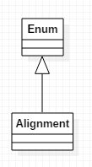
Review of enum Implementation in Java
In the Label example (earlier slide), each of the instances declared within the Alignment enum has type Alignment, which is a subclass of Enum. Therefore
Alignment is itself a class
Alignment is not allowed to inherit from any other class (multiple inheritance not allowed).

Slide 10
OPTIONAL - Using enums to Create Singletons
A singleton class is a class that can have at most one instance
Easy implementation using an enum:
enum MySingleton {
INSTANCE; //only one ordinal value here(0)
public void behavior() {}
}
//access it like this:
MySingleton.INSTANCE.behavior();

Slide 11
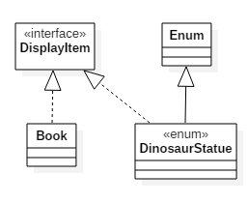
OPTIONAL : In Java 8, Enums Can “inherit”
//from lesson7.lecture.enums3.java8
interface DisplayItem {
default String displayInfo() {
. . .
}
}
class Book implements DisplayItem {
}
enum DinosaurStatue implements DisplayItem {
INSTANCE;
}
See lesson7.lecture.enums3.java7 and lesson7.lecture.enums3.java8

